Slide 1

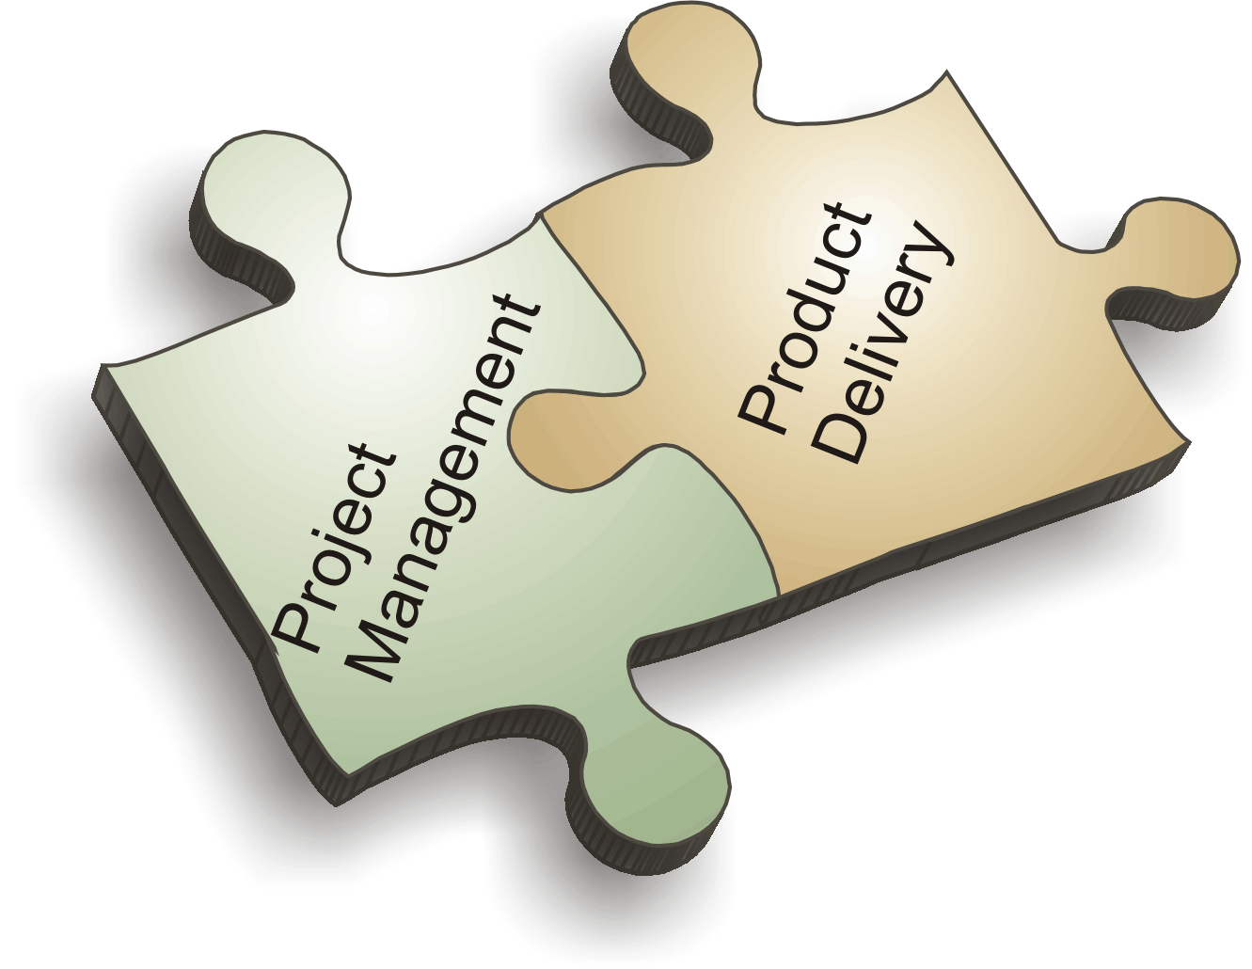
PROJECT MANAGEMENT
UNIT - III

Slide 2
THE PROJECT
A project is a unique endeavor to produce a set of deliverables within clearly specified time, cost and quality constraints.
Projects are different from standard business operational activities as they:
  Are unique in nature.
  Have a defined timescale.
  Have an approved budget.
  Have limited resources.
  Involve an element of risk.
  Achieve beneficial change.
Notes:
A project is a unique endeavor to produce a set of deliverables within clearly specified time, cost and quality constraints. Projects are different from standard business operational activities as they:
• Are unique in nature. They do not involve repetitive processes. Every project undertaken is different from the last, whereas operational activities often involve undertaking repetitive (identical) processes.
• Have a defined timescale. Projects have a clearly specified start and end date within which the deliverables must be produced to meet a specified customer requirement.
• Have an approved budget. Projects are allocated a level of financial expenditure within which the deliverables are produced, to meet a specified customer requirement.
• Have limited resources. At the start of a project an agreed amount of labor, equipment and materials is allocated to the project.
• Involve an element of risk. Projects entail a level of uncertainty and therefore carry business risk.
• Achieve beneficial change. The purpose of a project is typically to improve an organization through the implementation of business change.

Slide 3
THE PROJECT: Definition
Project can be defined as a temporary endeavor undertaken to accomplish a unique objective at goal.
- Project Management Institute (PMI)
Notes:
A project is a unique endeavor to produce a set of deliverables within clearly specified time, cost and quality constraints. Projects are different from standard business operational activities as they:
• Are unique in nature. They do not involve repetitive processes. Every project undertaken is different from the last, whereas operational activities often involve undertaking repetitive (identical) processes.
• Have a defined timescale. Projects have a clearly specified start and end date within which the deliverables must be produced to meet a specified customer requirement.
• Have an approved budget. Projects are allocated a level of financial expenditure within which the deliverables are produced, to meet a specified customer requirement.
• Have limited resources. At the start of a project an agreed amount of labor, equipment and materials is allocated to the project.
• Involve an element of risk. Projects entail a level of uncertainty and therefore carry business risk.
• Achieve beneficial change. The purpose of a project is typically to improve an organization through the implementation of business change.

Slide 4
THE PROJECT
A project is accomplished by performing a set of activities.
Ex:- Construction of a House
Activities involved:-
  Digging of foundation pits,
  Construction of Foundation,
  Construction of walls,
  Construction of roof,
  Fixing of doors and windows,
  Fixing of sanitary, fittings, wiring, fuel and power etc.
  Other Examples: Writing a Book, building a dam etc.
Notes:
A project is a unique endeavor to produce a set of deliverables within clearly specified time, cost and quality constraints. Projects are different from standard business operational activities as they:
• Are unique in nature. They do not involve repetitive processes. Every project undertaken is different from the last, whereas operational activities often involve undertaking repetitive (identical) processes.
• Have a defined timescale. Projects have a clearly specified start and end date within which the deliverables must be produced to meet a specified customer requirement.
• Have an approved budget. Projects are allocated a level of financial expenditure within which the deliverables are produced, to meet a specified customer requirement.
• Have limited resources. At the start of a project an agreed amount of labor, equipment and materials is allocated to the project.
• Involve an element of risk. Projects entail a level of uncertainty and therefore carry business risk.
• Achieve beneficial change. The purpose of a project is typically to improve an organization through the implementation of business change.

Slide 5
Project Management
Notes:
A project is a unique endeavor to produce a set of deliverables within clearly specified time, cost and quality constraints. Projects are different from standard business operational activities as they:
• Are unique in nature. They do not involve repetitive processes. Every project undertaken is different from the last, whereas operational activities often involve undertaking repetitive (identical) processes.
• Have a defined timescale. Projects have a clearly specified start and end date within which the deliverables must be produced to meet a specified customer requirement.
• Have an approved budget. Projects are allocated a level of financial expenditure within which the deliverables are produced, to meet a specified customer requirement.
• Have limited resources. At the start of a project an agreed amount of labor, equipment and materials is allocated to the project.
• Involve an element of risk. Projects entail a level of uncertainty and therefore carry business risk.
• Achieve beneficial change. The purpose of a project is typically to improve an organization through the implementation of business change.

Slide 6
Why Projects Fail???
Failure to align project with organizational objectives
Poor scope
Unrealistic expectations
Lack of executive sponsorship
Lack of project management
Inability to move beyond individual and personality conflicts
Politics

Slide 7
Why Projects Succeed!!!
Project Sponsorship at executive level
Good project charter (deed)
Strong project management
The right mix of team players
Good decision-making structure
Good communication
Team members are working towards common goals
Notes:
Good Charter includes good scope!
Put people in charge who have skills in leading and managing projects.

Slide 8
Is Project Management required???
Today’s complex environments require ongoing implementations
Project management is a method and mindset and a disciplined approach to managing chaos
Project management provides a framework for working amidst persistent change

Slide 9
Definition of Project Management
Project Management is the skills, tools and management processes required to undertake a project successfully. It incorporates:
  A set of skills.
  A suite of tools.
  A series of processes.
Notes:
Project Management is the skills, tools and management processes required to undertake a project successfully. It incorporates:
• A set of skills. Specialist knowledge, skills and experience are required to reduce the level of risk within a project and thereby enhance its likelihood of success.
• A suite of tools. Various types of tools are used by project managers to improve their chances of success. Examples include document templates, registers, planning software, modeling software, audit checklists and review forms.
• A series of processes. Various processes and techniques are required to monitor and control time, cost, quality and scope on projects. Examples include time management, cost management, quality management, change management, risk management and issue management.

Slide 10


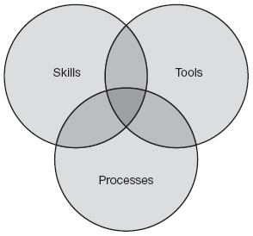

Components of Project Management

Slide 11
Project Management
Project management is about organization.
Project management is about decision making
Project management is about changing people’s behavior
Project management is about creating an environment conducive to getting critical projects done!

Slide 12
Planning the Project
The Project Life Cycle
Organizing the Project Team
Project Plans

Slide 13
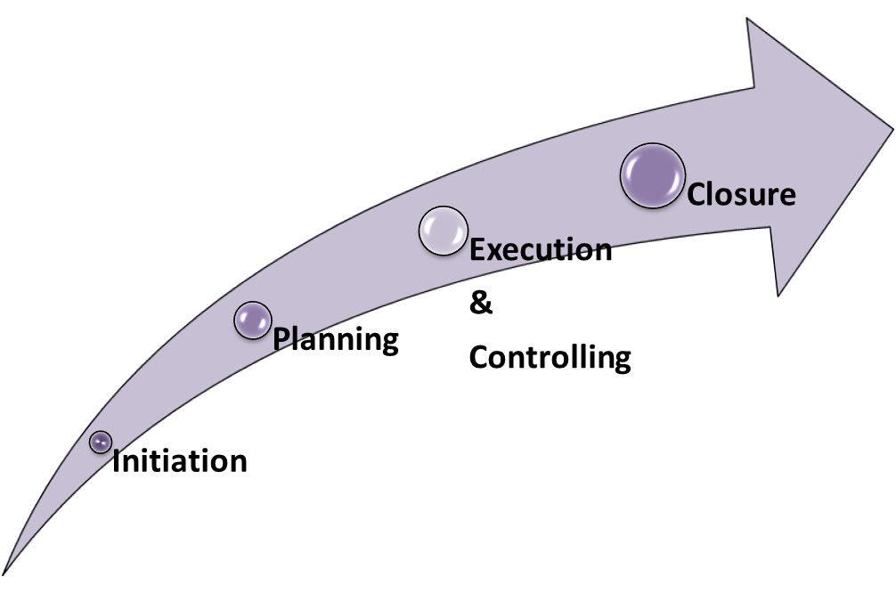
Planning the project:
PROJECT DEVELOPMENT CYCLE
The Project Life Cycle refers to a logical sequence of activities to accomplish the project’s goals or objectives.
Notes:
A project is a unique endeavor to produce a set of deliverables within clearly specified time, cost and quality constraints. Projects are different from standard business operational activities as they:
• Are unique in nature. They do not involve repetitive processes. Every project undertaken is different from the last, whereas operational activities often involve undertaking repetitive (identical) processes.
• Have a defined timescale. Projects have a clearly specified start and end date within which the deliverables must be produced to meet a specified customer requirement.
• Have an approved budget. Projects are allocated a level of financial expenditure within which the deliverables are produced, to meet a specified customer requirement.
• Have limited resources. At the start of a project an agreed amount of labor, equipment and materials is allocated to the project.
• Involve an element of risk. Projects entail a level of uncertainty and therefore carry business risk.
• Achieve beneficial change. The purpose of a project is typically to improve an organization through the implementation of business change.

Slide 14
PROJECT DEVELOPMENT CYCLE
  Initiation
In this first stage, the scope of the project is defined along with the approach to be taken to deliver the desired outputs. The project manager is appointed and in turn, he selects the team members based on their skills and experience. The most common tools or methodologies used in the initiation stage are:
  Project Charter,
  Business Plan,
  Project Framework (or Overview),
  Business Case Justification, and
  Milestones Reviews.
Notes:
A project is a unique endeavor to produce a set of deliverables within clearly specified time, cost and quality constraints. Projects are different from standard business operational activities as they:
• Are unique in nature. They do not involve repetitive processes. Every project undertaken is different from the last, whereas operational activities often involve undertaking repetitive (identical) processes.
• Have a defined timescale. Projects have a clearly specified start and end date within which the deliverables must be produced to meet a specified customer requirement.
• Have an approved budget. Projects are allocated a level of financial expenditure within which the deliverables are produced, to meet a specified customer requirement.
• Have limited resources. At the start of a project an agreed amount of labor, equipment and materials is allocated to the project.
• Involve an element of risk. Projects entail a level of uncertainty and therefore carry business risk.
• Achieve beneficial change. The purpose of a project is typically to improve an organization through the implementation of business change.

Slide 15
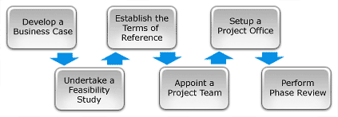
PROJECT DEVELOPMENT CYCLE
1. Initiation
Notes:
Project Initiation is the first phase in the Project Life Cycle and essentially involves starting up the project.
In this first stage, the scope of the project is defined along with the approach to be taken to deliver the desired outputs. The project manager is appointed and in turn, he selects the team members based on their skills and experience.
You will also need to recruit a suitably skilled project team, set up a Project Office and perform an end of Phase Review. The Project Initiation phase involves the six key steps

Slide 16
PROJECT DEVELOPMENT CYCLE
  2) Planning
The second phase should include a detailed identification and assignment of each task until the end of the project. It should also include a risk analysis and a definition of a criteria for the successful completion of each deliverable.
The governance process is defined, stake holders identified and reporting frequency and channels agreed. The most common tools or methodologies used in the planning stage are Business Plan and Milestones Reviews.
Notes:
A project is a unique endeavor to produce a set of deliverables within clearly specified time, cost and quality constraints. Projects are different from standard business operational activities as they:
• Are unique in nature. They do not involve repetitive processes. Every project undertaken is different from the last, whereas operational activities often involve undertaking repetitive (identical) processes.
• Have a defined timescale. Projects have a clearly specified start and end date within which the deliverables must be produced to meet a specified customer requirement.
• Have an approved budget. Projects are allocated a level of financial expenditure within which the deliverables are produced, to meet a specified customer requirement.
• Have limited resources. At the start of a project an agreed amount of labor, equipment and materials is allocated to the project.
• Involve an element of risk. Projects entail a level of uncertainty and therefore carry business risk.
• Achieve beneficial change. The purpose of a project is typically to improve an organization through the implementation of business change.

Slide 17
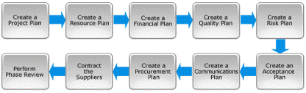
PROJECT DEVELOPMENT CYCLE
2. Planning
Notes:
After defining the project and appointing the project team, you're ready to enter the detailed Project Planning phase. This involves creating a suite of planning documents to help guide the team throughout the project delivery. The Planning with 10 key steps

Slide 18
PROJECT DEVELOPMENT CYCLE
3) Execution and controlling
The most important issue in this phase is to ensure project activities are properly executed and controlled. During the execution phase, the planned solution is implemented to solve the problem specified in the project's requirements.
In product and system development, a design resulting in a specific set of product requirements is created. This convergence is measured by prototypes, testing, and reviews. As the execution phase progresses, groups across the organization become more deeply involved in planning for the final testing, production, and support. The most common tools or methodologies used in the execution phase are an update of Risk Analysis and Score Cards, in addition to Business Plan and Milestones Reviews.
Notes:
A project is a unique endeavor to produce a set of deliverables within clearly specified time, cost and quality constraints. Projects are different from standard business operational activities as they:
• Are unique in nature. They do not involve repetitive processes. Every project undertaken is different from the last, whereas operational activities often involve undertaking repetitive (identical) processes.
• Have a defined timescale. Projects have a clearly specified start and end date within which the deliverables must be produced to meet a specified customer requirement.
• Have an approved budget. Projects are allocated a level of financial expenditure within which the deliverables are produced, to meet a specified customer requirement.
• Have limited resources. At the start of a project an agreed amount of labor, equipment and materials is allocated to the project.
• Involve an element of risk. Projects entail a level of uncertainty and therefore carry business risk.
• Achieve beneficial change. The purpose of a project is typically to improve an organization through the implementation of business change.

Slide 19
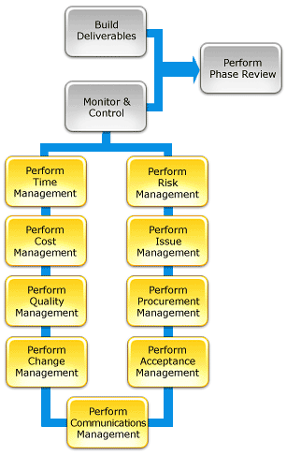
PROJECT DEVELOPMENT CYCLE
3. Execution and Controlling
Notes:
The most important issue in this phase is to ensure project activities are properly executed and controlled. During the execution phase, the planned solution is implemented to solve the problem specified in the project's requirements. As the execution phase progresses, groups across the organization become more deeply involved in planning for the final testing, production, and support.
These processes include managing time, cost, quality, change, risks, issues, suppliers, customers and communication.

Slide 20
PROJECT DEVELOPMENT CYCLE
4) Closure
In this last stage, the project manager must ensure that the project is brought to its proper completion. The closure phase is characterized by a written formal project review report containing the following components:
- a formal acceptance of the final product by the client,
- Weighted Critical Measurements (matching the initial requirements specified by the client with the final delivered product),
- rewarding the team, a list of lessons learned, releasing project resources, and a formal project closure notification to higher management.
No special tool or methodology is needed during the closure phase.
Notes:
A project is a unique endeavor to produce a set of deliverables within clearly specified time, cost and quality constraints. Projects are different from standard business operational activities as they:
• Are unique in nature. They do not involve repetitive processes. Every project undertaken is different from the last, whereas operational activities often involve undertaking repetitive (identical) processes.
• Have a defined timescale. Projects have a clearly specified start and end date within which the deliverables must be produced to meet a specified customer requirement.
• Have an approved budget. Projects are allocated a level of financial expenditure within which the deliverables are produced, to meet a specified customer requirement.
• Have limited resources. At the start of a project an agreed amount of labor, equipment and materials is allocated to the project.
• Involve an element of risk. Projects entail a level of uncertainty and therefore carry business risk.
• Achieve beneficial change. The purpose of a project is typically to improve an organization through the implementation of business change.

Slide 21

PROJECT DEVELOPMENT CYCLE
4. Closure
Notes:
In this last stage, the project manager must ensure that the project is brought to its proper completion. The closure phase is characterized by a written formal project review report containing the following components: a formal acceptance of the final product by the client, Weighted Critical Measurements (matching the initial requirements specified by the client with the final delivered product), rewarding the team, a list of lessons learned, releasing project resources, and a formal project closure notification to higher management. No special tool or methodology is needed during the closure phase.

Slide 22
Planning the project:
Project Plans
Notes:
This section discusses some of the specific skills you will need to run projects successfully. It concentrates on two main areas: scheduling skills, including use of Gantt charts and Critical Path Analysis, and overall project planning following the Planning Cycle.
We look at these tools:
Estimating Time Accurately
Scheduling Simple Projects
Gantt Charts – Scheduling Projects with Dependent Stages
Critical Path Analysis and PERT – Scheduling Complex Projects
The Planning Cycle – A Planning Process for Middle-Sized Projects

Slide 23
Planning the project:
Project Plans
Estimating Time Accurately
Scheduling Simple Projects
Gantt Charts – Scheduling Projects with Dependent Stages
Critical Path Analysis and PERT – Scheduling Complex Projects
The Planning Cycle – A Planning Process for Middle-Sized Projects
Notes:
This section discusses some of the specific skills you will need to run projects successfully. It concentrates on two main areas: scheduling skills, including use of Gantt charts and Critical Path Analysis, and overall project planning following the Planning Cycle.
We look at these tools:
Estimating Time Accurately
Scheduling Simple Projects
Gantt Charts – Scheduling Projects with Dependent Stages
Critical Path Analysis and PERT – Scheduling Complex Projects
The Planning Cycle – A Planning Process for Middle-Sized Projects

Slide 24
Planning the project:
Organizing the Project Team
Project Leader
The Team
Work Methods and Procedures
Work Plan
Notes:
Project Leader
Ideally, the project leader should be familiar with not only the subject field in question but also the principles and methods of terminology work. In selecting team members, the leader should take into account the subject field under study, the user needs and the need for a balanced representation of all parties concerned.
The Team
A team composed of subject-field experts and language professionals including at least one professional terminologist, produces the best results. Depending on the type of project, the terminologist may be formally part of the team or may be brought in as an outside consultant.
Work Methods and Procedures
The work methods and procedures must be clear to all the team members. The project leader should ensure that all members are made familiar with the basic methodology to be used and with all applicable technical standards. Team members must have access to all ISO/TC 37 technical standards, general-language dictionaries, specialized glossaries in the field under study and all other appropriate resources. Every effort should be made to adhere to established technical standards in terminology and to maximize the use of existing terminology in the field.
The work plan should include a description of the subject field (stipulating the subfields to be included and excluded), the languages involved and the number of concepts to be studied. If the number of concepts is judged to exceed the parameters of the project, the work may be subdivided into parallel or successive subprojects.
The work plan should also include a detailed schedule specifying the time frame and target date for each phase of the work and the responsibilities of each team member.

Slide 25
Project Appraisal
Notes:
A project is a unique endeavor to produce a set of deliverables within clearly specified time, cost and quality constraints. Projects are different from standard business operational activities as they:
• Are unique in nature. They do not involve repetitive processes. Every project undertaken is different from the last, whereas operational activities often involve undertaking repetitive (identical) processes.
• Have a defined timescale. Projects have a clearly specified start and end date within which the deliverables must be produced to meet a specified customer requirement.
• Have an approved budget. Projects are allocated a level of financial expenditure within which the deliverables are produced, to meet a specified customer requirement.
• Have limited resources. At the start of a project an agreed amount of labor, equipment and materials is allocated to the project.
• Involve an element of risk. Projects entail a level of uncertainty and therefore carry business risk.
• Achieve beneficial change. The purpose of a project is typically to improve an organization through the implementation of business change.

Slide 26

Project Appraisal
Meaning and definition
Various aspects of project appraisal
Notes:
A project is a unique endeavor to produce a set of deliverables within clearly specified time, cost and quality constraints. Projects are different from standard business operational activities as they:
• Are unique in nature. They do not involve repetitive processes. Every project undertaken is different from the last, whereas operational activities often involve undertaking repetitive (identical) processes.
• Have a defined timescale. Projects have a clearly specified start and end date within which the deliverables must be produced to meet a specified customer requirement.
• Have an approved budget. Projects are allocated a level of financial expenditure within which the deliverables are produced, to meet a specified customer requirement.
• Have limited resources. At the start of a project an agreed amount of labor, equipment and materials is allocated to the project.
• Involve an element of risk. Projects entail a level of uncertainty and therefore carry business risk.
• Achieve beneficial change. The purpose of a project is typically to improve an organization through the implementation of business change.

Slide 27
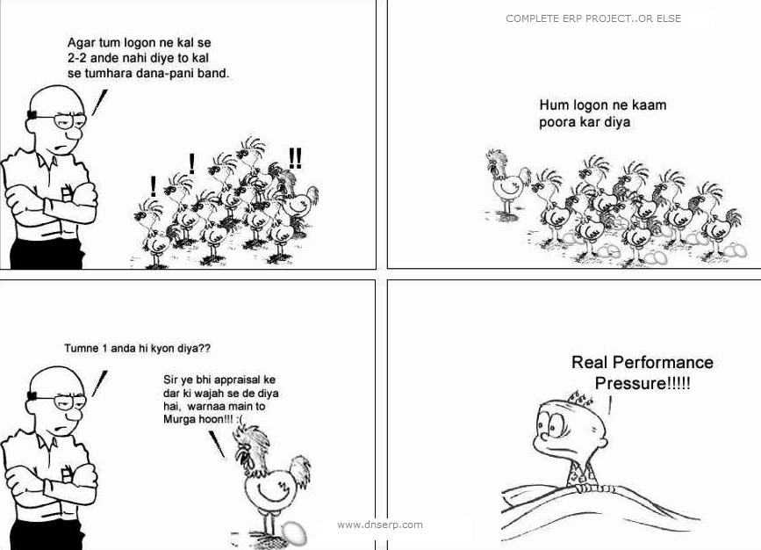
Appraisal
Notes:
A project is a unique endeavor to produce a set of deliverables within clearly specified time, cost and quality constraints. Projects are different from standard business operational activities as they:
• Are unique in nature. They do not involve repetitive processes. Every project undertaken is different from the last, whereas operational activities often involve undertaking repetitive (identical) processes.
• Have a defined timescale. Projects have a clearly specified start and end date within which the deliverables must be produced to meet a specified customer requirement.
• Have an approved budget. Projects are allocated a level of financial expenditure within which the deliverables are produced, to meet a specified customer requirement.
• Have limited resources. At the start of a project an agreed amount of labor, equipment and materials is allocated to the project.
• Involve an element of risk. Projects entail a level of uncertainty and therefore carry business risk.
• Achieve beneficial change. The purpose of a project is typically to improve an organization through the implementation of business change.

Slide 28
Appraisal or Pressure???
To check viability
Notes:
A project is a unique endeavor to produce a set of deliverables within clearly specified time, cost and quality constraints. Projects are different from standard business operational activities as they:
• Are unique in nature. They do not involve repetitive processes. Every project undertaken is different from the last, whereas operational activities often involve undertaking repetitive (identical) processes.
• Have a defined timescale. Projects have a clearly specified start and end date within which the deliverables must be produced to meet a specified customer requirement.
• Have an approved budget. Projects are allocated a level of financial expenditure within which the deliverables are produced, to meet a specified customer requirement.
• Have limited resources. At the start of a project an agreed amount of labor, equipment and materials is allocated to the project.
• Involve an element of risk. Projects entail a level of uncertainty and therefore carry business risk.
• Achieve beneficial change. The purpose of a project is typically to improve an organization through the implementation of business change.

Slide 29
Project Appraisal
Meaning and definition
Assessment of a project in terms of its economic, social and financial viability
A lending financial institution makes an independent and objective assessment of various aspects of an investment proposition
It is defined as taking a second look critically and carefully at a project by a person who is in no way involved or connected with its preparation. He is able to take independent, dispassionate and objective view of the project in totality, along with its various components
It is a detailed study of several aspects of a given project before recommending it.
Notes:
A project is a unique endeavor to produce a set of deliverables within clearly specified time, cost and quality constraints. Projects are different from standard business operational activities as they:
• Are unique in nature. They do not involve repetitive processes. Every project undertaken is different from the last, whereas operational activities often involve undertaking repetitive (identical) processes.
• Have a defined timescale. Projects have a clearly specified start and end date within which the deliverables must be produced to meet a specified customer requirement.
• Have an approved budget. Projects are allocated a level of financial expenditure within which the deliverables are produced, to meet a specified customer requirement.
• Have limited resources. At the start of a project an agreed amount of labor, equipment and materials is allocated to the project.
• Involve an element of risk. Projects entail a level of uncertainty and therefore carry business risk.
• Achieve beneficial change. The purpose of a project is typically to improve an organization through the implementation of business change.

Slide 30
Project Appraisal
Steps for project appraisal/Aspects of project appraisal
Economic Aspects
Technical Aspects
Organizational Aspects
Managerial Aspects
Financial Aspects
Market/Commercial Aspects
Notes:
A project is a unique endeavor to produce a set of deliverables within clearly specified time, cost and quality constraints. Projects are different from standard business operational activities as they:
• Are unique in nature. They do not involve repetitive processes. Every project undertaken is different from the last, whereas operational activities often involve undertaking repetitive (identical) processes.
• Have a defined timescale. Projects have a clearly specified start and end date within which the deliverables must be produced to meet a specified customer requirement.
• Have an approved budget. Projects are allocated a level of financial expenditure within which the deliverables are produced, to meet a specified customer requirement.
• Have limited resources. At the start of a project an agreed amount of labor, equipment and materials is allocated to the project.
• Involve an element of risk. Projects entail a level of uncertainty and therefore carry business risk.
• Achieve beneficial change. The purpose of a project is typically to improve an organization through the implementation of business change.

Slide 31
Project Appraisal
Steps for project appraisal/Aspects of project appraisal
Step | Aspects | Process of security
1 | Economic | Indicate priority use
2 | Technical | Involves scale of the project and the process adopted
3 | Organizational | Suitability is examined
4 | Managerial | Adequacy and competency are critically important
5 | Operational | Capacity of the project
6 | Financial | Determines the financial viability.
Notes:
A project is a unique endeavor to produce a set of deliverables within clearly specified time, cost and quality constraints. Projects are different from standard business operational activities as they:
• Are unique in nature. They do not involve repetitive processes. Every project undertaken is different from the last, whereas operational activities often involve undertaking repetitive (identical) processes.
• Have a defined timescale. Projects have a clearly specified start and end date within which the deliverables must be produced to meet a specified customer requirement.
• Have an approved budget. Projects are allocated a level of financial expenditure within which the deliverables are produced, to meet a specified customer requirement.
• Have limited resources. At the start of a project an agreed amount of labor, equipment and materials is allocated to the project.
• Involve an element of risk. Projects entail a level of uncertainty and therefore carry business risk.
• Achieve beneficial change. The purpose of a project is typically to improve an organization through the implementation of business change.

Slide 32
Project Appraisal
Economic Aspects
It measures the effect of the project on the whole economy.
Analyses if the benefits will justify the project cost/investment done
A successful project gives following benefits:
  Increased output
  Enhanced services
  Increased employment
  Larger government revenue
  Higher earnings
  Higher standard of living
  Increased national income
  Improved income distribution
Generally an entrepreneur concentrates over only his profit whereas policy makers concern the return for whole economy
Notes:
A project is a unique endeavor to produce a set of deliverables within clearly specified time, cost and quality constraints. Projects are different from standard business operational activities as they:
• Are unique in nature. They do not involve repetitive processes. Every project undertaken is different from the last, whereas operational activities often involve undertaking repetitive (identical) processes.
• Have a defined timescale. Projects have a clearly specified start and end date within which the deliverables must be produced to meet a specified customer requirement.
• Have an approved budget. Projects are allocated a level of financial expenditure within which the deliverables are produced, to meet a specified customer requirement.
• Have limited resources. At the start of a project an agreed amount of labor, equipment and materials is allocated to the project.
• Involve an element of risk. Projects entail a level of uncertainty and therefore carry business risk.
• Achieve beneficial change. The purpose of a project is typically to improve an organization through the implementation of business change.

Slide 33
Project Appraisal
Technical Aspects
It measures the effect of the project on the basis of techniques used as:
Site and Location: RM supply, proximity to markets, transportation facility, power supply, manpower, water, government policies, labour laws, climate, taxes
Plant layout/scale of operations: Technological capacity is standardised for achieving economies of scale, low demand or less resource availability result in economies of scale
Technical feasibility: Technology selected, availability of infrastructure, plant layout, project implementation schedules etc
Notes:
A project is a unique endeavor to produce a set of deliverables within clearly specified time, cost and quality constraints. Projects are different from standard business operational activities as they:
• Are unique in nature. They do not involve repetitive processes. Every project undertaken is different from the last, whereas operational activities often involve undertaking repetitive (identical) processes.
• Have a defined timescale. Projects have a clearly specified start and end date within which the deliverables must be produced to meet a specified customer requirement.
• Have an approved budget. Projects are allocated a level of financial expenditure within which the deliverables are produced, to meet a specified customer requirement.
• Have limited resources. At the start of a project an agreed amount of labor, equipment and materials is allocated to the project.
• Involve an element of risk. Projects entail a level of uncertainty and therefore carry business risk.
• Achieve beneficial change. The purpose of a project is typically to improve an organization through the implementation of business change.

Slide 34
Project Appraisal
Technical Aspects
It measures the effect of the project on the basis of techniques used as:
Factors affecting Site Selection of plant:
Location of raw material
Labour
Site
Industrial fuel
Transportation facilities
Markets
Distribution Facilities
Power, Water, Living Condition, climate
Laws and Regulation
Tax Structure
Notes:
A project is a unique endeavor to produce a set of deliverables within clearly specified time, cost and quality constraints. Projects are different from standard business operational activities as they:
• Are unique in nature. They do not involve repetitive processes. Every project undertaken is different from the last, whereas operational activities often involve undertaking repetitive (identical) processes.
• Have a defined timescale. Projects have a clearly specified start and end date within which the deliverables must be produced to meet a specified customer requirement.
• Have an approved budget. Projects are allocated a level of financial expenditure within which the deliverables are produced, to meet a specified customer requirement.
• Have limited resources. At the start of a project an agreed amount of labor, equipment and materials is allocated to the project.
• Involve an element of risk. Projects entail a level of uncertainty and therefore carry business risk.
• Achieve beneficial change. The purpose of a project is typically to improve an organization through the implementation of business change.

Slide 35
Project Appraisal
Technical Aspects
It measures the effect of the project on the basis of techniques used as:
Factors affecting Project Location:
Availability of raw material
Availability of skilled and unskilled labour
Nearness to the source of Motive Power
Nearness to the market
Availability of Transport Facilities
Topography
Soil Condition
Waste disposal
Power and Water supply
Tax Concession
Living conditions for labour and management
Notes:
A project is a unique endeavor to produce a set of deliverables within clearly specified time, cost and quality constraints. Projects are different from standard business operational activities as they:
• Are unique in nature. They do not involve repetitive processes. Every project undertaken is different from the last, whereas operational activities often involve undertaking repetitive (identical) processes.
• Have a defined timescale. Projects have a clearly specified start and end date within which the deliverables must be produced to meet a specified customer requirement.
• Have an approved budget. Projects are allocated a level of financial expenditure within which the deliverables are produced, to meet a specified customer requirement.
• Have limited resources. At the start of a project an agreed amount of labor, equipment and materials is allocated to the project.
• Involve an element of risk. Projects entail a level of uncertainty and therefore carry business risk.
• Achieve beneficial change. The purpose of a project is typically to improve an organization through the implementation of business change.

Slide 36
Project Appraisal
Technical Aspects
Plant Layout : Objectives
Minimum material handling
Reduced manufacturing cost
Ensured output in quality and quantity
Flexibility to meet changing needs
High turnover of work-in process
Low investment in equipment
Effective use of floor space
Best utilization of equipment and facilities
Reduced work delays and stoppages
Effective utilization of manpower
Notes:
A project is a unique endeavor to produce a set of deliverables within clearly specified time, cost and quality constraints. Projects are different from standard business operational activities as they:
• Are unique in nature. They do not involve repetitive processes. Every project undertaken is different from the last, whereas operational activities often involve undertaking repetitive (identical) processes.
• Have a defined timescale. Projects have a clearly specified start and end date within which the deliverables must be produced to meet a specified customer requirement.
• Have an approved budget. Projects are allocated a level of financial expenditure within which the deliverables are produced, to meet a specified customer requirement.
• Have limited resources. At the start of a project an agreed amount of labor, equipment and materials is allocated to the project.
• Involve an element of risk. Projects entail a level of uncertainty and therefore carry business risk.
• Achieve beneficial change. The purpose of a project is typically to improve an organization through the implementation of business change.

Slide 37
Project Appraisal
Technical Aspects
Factors affecting Plant Layout
Plant Location
Plant Environment
Product
Production system
Space requirements
Repair and maintenance
Balancing of Machine Capacity
Management Policy
Notes:
A project is a unique endeavor to produce a set of deliverables within clearly specified time, cost and quality constraints. Projects are different from standard business operational activities as they:
• Are unique in nature. They do not involve repetitive processes. Every project undertaken is different from the last, whereas operational activities often involve undertaking repetitive (identical) processes.
• Have a defined timescale. Projects have a clearly specified start and end date within which the deliverables must be produced to meet a specified customer requirement.
• Have an approved budget. Projects are allocated a level of financial expenditure within which the deliverables are produced, to meet a specified customer requirement.
• Have limited resources. At the start of a project an agreed amount of labor, equipment and materials is allocated to the project.
• Involve an element of risk. Projects entail a level of uncertainty and therefore carry business risk.
• Achieve beneficial change. The purpose of a project is typically to improve an organization through the implementation of business change.

Slide 38
Technical Aspect
Various aspects are measured under this head as:
Selection of appropriate Technology (This must satisfy the following questions)
  Does the Technology make use of the locally available Raw Material?
  Can the technology implement and maintained by the locally available man power?
  Is the technology in tune with the local social and cultural conditions?
  Does the technology protects ecological balance etc?
Example:
As cement can be manufactured wither by wet process or by the dry process.
Notes:
A project is a unique endeavor to produce a set of deliverables within clearly specified time, cost and quality constraints. Projects are different from standard business operational activities as they:
• Are unique in nature. They do not involve repetitive processes. Every project undertaken is different from the last, whereas operational activities often involve undertaking repetitive (identical) processes.
• Have a defined timescale. Projects have a clearly specified start and end date within which the deliverables must be produced to meet a specified customer requirement.
• Have an approved budget. Projects are allocated a level of financial expenditure within which the deliverables are produced, to meet a specified customer requirement.
• Have limited resources. At the start of a project an agreed amount of labor, equipment and materials is allocated to the project.
• Involve an element of risk. Projects entail a level of uncertainty and therefore carry business risk.
• Achieve beneficial change. The purpose of a project is typically to improve an organization through the implementation of business change.

Slide 39
Technical Aspect
Contd:
Scale of Operations (signified by the size of the plant)
Raw Material (may be replaced by alternative Raw Material, hence alternative process may be required)
Technical Know-How (expert consultant must have knowledge and experience and such project earlier successfully)
Collaboration Agreements (the agreement should be specified as to the part played by know-how supplier)
Product Mix (Variation in product according to the customers)
Selection and Procurement of Plant and Machinery
Plant layout (For steady flow of production and minimizing overall cost)
Location of Project (regional Factor, Site Factor)
Project Scheduling (Scheduling of activities)
Notes:
A project is a unique endeavor to produce a set of deliverables within clearly specified time, cost and quality constraints. Projects are different from standard business operational activities as they:
• Are unique in nature. They do not involve repetitive processes. Every project undertaken is different from the last, whereas operational activities often involve undertaking repetitive (identical) processes.
• Have a defined timescale. Projects have a clearly specified start and end date within which the deliverables must be produced to meet a specified customer requirement.
• Have an approved budget. Projects are allocated a level of financial expenditure within which the deliverables are produced, to meet a specified customer requirement.
• Have limited resources. At the start of a project an agreed amount of labor, equipment and materials is allocated to the project.
• Involve an element of risk. Projects entail a level of uncertainty and therefore carry business risk.
• Achieve beneficial change. The purpose of a project is typically to improve an organization through the implementation of business change.

Slide 40
Project Appraisal
Organizational Aspects
Organization structure, recruitment and training aspects are studied
Appraisal done to see if project is adequately staffed, initial recruitment is done
Notes:
A project is a unique endeavor to produce a set of deliverables within clearly specified time, cost and quality constraints. Projects are different from standard business operational activities as they:
• Are unique in nature. They do not involve repetitive processes. Every project undertaken is different from the last, whereas operational activities often involve undertaking repetitive (identical) processes.
• Have a defined timescale. Projects have a clearly specified start and end date within which the deliverables must be produced to meet a specified customer requirement.
• Have an approved budget. Projects are allocated a level of financial expenditure within which the deliverables are produced, to meet a specified customer requirement.
• Have limited resources. At the start of a project an agreed amount of labor, equipment and materials is allocated to the project.
• Involve an element of risk. Projects entail a level of uncertainty and therefore carry business risk.
• Achieve beneficial change. The purpose of a project is typically to improve an organization through the implementation of business change.

Slide 41
Project Appraisal
Managerial Aspects
Financial institutions check if promoters are competent and have business sense
They can appoint nominee directors on board
The Companies Act and Industries Act empower government to exercise control over management
They can also take over the management in case it is needed
Notes:
A project is a unique endeavor to produce a set of deliverables within clearly specified time, cost and quality constraints. Projects are different from standard business operational activities as they:
• Are unique in nature. They do not involve repetitive processes. Every project undertaken is different from the last, whereas operational activities often involve undertaking repetitive (identical) processes.
• Have a defined timescale. Projects have a clearly specified start and end date within which the deliverables must be produced to meet a specified customer requirement.
• Have an approved budget. Projects are allocated a level of financial expenditure within which the deliverables are produced, to meet a specified customer requirement.
• Have limited resources. At the start of a project an agreed amount of labor, equipment and materials is allocated to the project.
• Involve an element of risk. Projects entail a level of uncertainty and therefore carry business risk.
• Achieve beneficial change. The purpose of a project is typically to improve an organization through the implementation of business change.

Slide 42
Project Appraisal
Managerial Appraisal Scope
Integrity
Foresightedness
Leadership Qualities
Inter-personnel Relationship
Technical and Financial skills
Commitment
Perseverance
Notes:
A project is a unique endeavor to produce a set of deliverables within clearly specified time, cost and quality constraints. Projects are different from standard business operational activities as they:
• Are unique in nature. They do not involve repetitive processes. Every project undertaken is different from the last, whereas operational activities often involve undertaking repetitive (identical) processes.
• Have a defined timescale. Projects have a clearly specified start and end date within which the deliverables must be produced to meet a specified customer requirement.
• Have an approved budget. Projects are allocated a level of financial expenditure within which the deliverables are produced, to meet a specified customer requirement.
• Have limited resources. At the start of a project an agreed amount of labor, equipment and materials is allocated to the project.
• Involve an element of risk. Projects entail a level of uncertainty and therefore carry business risk.
• Achieve beneficial change. The purpose of a project is typically to improve an organization through the implementation of business change.

Slide 43
Project Appraisal
Financial Aspects
Cost analysis: Finding out the cost of production
Pricing: Deciding price of the product after considering demand, profit and competition
Financing: Raising funds and efficient use of the same
Income and Expenditure: Concerned with predicting profit and costs involved
Notes:
A project is a unique endeavor to produce a set of deliverables within clearly specified time, cost and quality constraints. Projects are different from standard business operational activities as they:
• Are unique in nature. They do not involve repetitive processes. Every project undertaken is different from the last, whereas operational activities often involve undertaking repetitive (identical) processes.
• Have a defined timescale. Projects have a clearly specified start and end date within which the deliverables must be produced to meet a specified customer requirement.
• Have an approved budget. Projects are allocated a level of financial expenditure within which the deliverables are produced, to meet a specified customer requirement.
• Have limited resources. At the start of a project an agreed amount of labor, equipment and materials is allocated to the project.
• Involve an element of risk. Projects entail a level of uncertainty and therefore carry business risk.
• Achieve beneficial change. The purpose of a project is typically to improve an organization through the implementation of business change.

Slide 44
Project Appraisal
Financial Appraisal Objectives
Financial Soundness
Efficient operation
Cost of Project
Return on Investment
Prospects of Marketing
Profitability
Effective Control
Budgeting
Pricing
Notes:
A project is a unique endeavor to produce a set of deliverables within clearly specified time, cost and quality constraints. Projects are different from standard business operational activities as they:
• Are unique in nature. They do not involve repetitive processes. Every project undertaken is different from the last, whereas operational activities often involve undertaking repetitive (identical) processes.
• Have a defined timescale. Projects have a clearly specified start and end date within which the deliverables must be produced to meet a specified customer requirement.
• Have an approved budget. Projects are allocated a level of financial expenditure within which the deliverables are produced, to meet a specified customer requirement.
• Have limited resources. At the start of a project an agreed amount of labor, equipment and materials is allocated to the project.
• Involve an element of risk. Projects entail a level of uncertainty and therefore carry business risk.
• Achieve beneficial change. The purpose of a project is typically to improve an organization through the implementation of business change.

Slide 45
Project Appraisal
Financial Appraisal Scope
Cost Analysis
Pricing
Financing
Income and Expenditure
Notes:
A project is a unique endeavor to produce a set of deliverables within clearly specified time, cost and quality constraints. Projects are different from standard business operational activities as they:
• Are unique in nature. They do not involve repetitive processes. Every project undertaken is different from the last, whereas operational activities often involve undertaking repetitive (identical) processes.
• Have a defined timescale. Projects have a clearly specified start and end date within which the deliverables must be produced to meet a specified customer requirement.
• Have an approved budget. Projects are allocated a level of financial expenditure within which the deliverables are produced, to meet a specified customer requirement.
• Have limited resources. At the start of a project an agreed amount of labor, equipment and materials is allocated to the project.
• Involve an element of risk. Projects entail a level of uncertainty and therefore carry business risk.
• Achieve beneficial change. The purpose of a project is typically to improve an organization through the implementation of business change.

Slide 46
Project Appraisal
Market / Commercial Aspects
Analysis of market opportunities
Specification of marketing objectives
Planning and organizing of marketing process
Controlling of implementation of marketing plan
Notes:
A project is a unique endeavor to produce a set of deliverables within clearly specified time, cost and quality constraints. Projects are different from standard business operational activities as they:
• Are unique in nature. They do not involve repetitive processes. Every project undertaken is different from the last, whereas operational activities often involve undertaking repetitive (identical) processes.
• Have a defined timescale. Projects have a clearly specified start and end date within which the deliverables must be produced to meet a specified customer requirement.
• Have an approved budget. Projects are allocated a level of financial expenditure within which the deliverables are produced, to meet a specified customer requirement.
• Have limited resources. At the start of a project an agreed amount of labor, equipment and materials is allocated to the project.
• Involve an element of risk. Projects entail a level of uncertainty and therefore carry business risk.
• Achieve beneficial change. The purpose of a project is typically to improve an organization through the implementation of business change.

Slide 47
Project Appraisal
Market Techniques
Marketing involves following activities:
Research
Planning
Branding
Pricing (Value, Status, Quality, Durability)
Distribution
Selling
Packaging
Warehousing
Sales promotion
Advertising
Credit Control
Notes:
A project is a unique endeavor to produce a set of deliverables within clearly specified time, cost and quality constraints. Projects are different from standard business operational activities as they:
• Are unique in nature. They do not involve repetitive processes. Every project undertaken is different from the last, whereas operational activities often involve undertaking repetitive (identical) processes.
• Have a defined timescale. Projects have a clearly specified start and end date within which the deliverables must be produced to meet a specified customer requirement.
• Have an approved budget. Projects are allocated a level of financial expenditure within which the deliverables are produced, to meet a specified customer requirement.
• Have limited resources. At the start of a project an agreed amount of labor, equipment and materials is allocated to the project.
• Involve an element of risk. Projects entail a level of uncertainty and therefore carry business risk.
• Achieve beneficial change. The purpose of a project is typically to improve an organization through the implementation of business change.

